Slide 1
Concept and Classification
of
Economic Activities
Kaustuv Mukherjee
Asstt. Prof. in Geography
Chandidas Mahavidyalaya

Slide 2
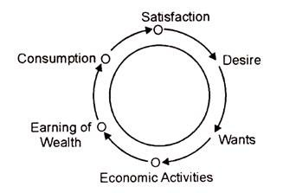
Concept:
Economic activity is the activity of making, providing, purchasing, or selling goods or services.
Any action that involves producing, distributing, or consuming products or services is an economic activity. Economic activities exist at all levels within a society.
Additionally, any activities involving money or the exchange of products or services are economic activities.

Slide 3
Definition:
Cambridge Dictionary -
“The activity of producing, buying, or selling products or services.”
The University of Toronto’s Department of Economics –
“Economic activity is the process by which the stock of resources or stock of capital produces a flow of output of goods and services that people utilize in partial satisfaction of their unlimited wants.”

Slide 4
Economic activity – classifications
Economists say there are four basic types of economic activities:
– The Primary Sector, i.e., raw materials.
– The Secondary Sector, which includes industry and manufacturing.
– The Tertiary Sector, i.e., services.
– The Quaternary Sector, which we also call the ‘knowledge sector.’
- The Quinary Sector, managerial services

Slide 5
The Primary Sector
Direct Extraction of Materials and Production from Nature
Example: Agriculture, Fisheries, Forestry, Mining and Quarrying
Red Collar Workers

Slide 6
The Secondary Sector
Processing, transformation, qualitative upgradation of primary raw materials
Examples: Household and manufacturing Industries
Blue Collar Workers

Slide 7
The Tertiary Sector
Mainly services, Distribution, Exchange and Consumption of Goods
Examples: Trade, Transport, Communication services
Pink Collar Workers

Slide 8
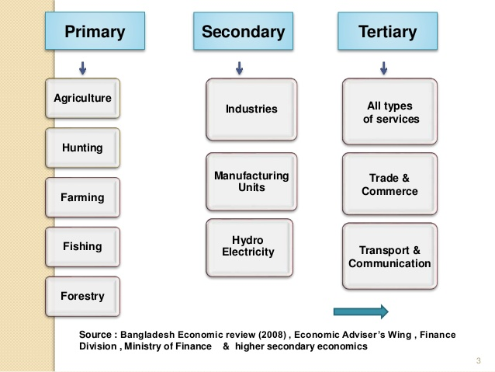

Slide 9
The Quaternary Sector
Knowledge sector and administrative Services
Examples: Banking, Hospital Services, Teaching, Research, Information Services, Govt. Services
White Collar Workers

Slide 10
The Quinary Sector
High Level Managerial and Executive Services, mainly planners and Decision makers
Examples: Ministrial job, Planning, Management, Decision making
Gold Collar Workers

Slide 11
Quinary
Quaternary
Tertiary
Secondary
Primary

Slide 12
Thank You

